Slide 1
Intro to Machine Learning with TensorFLow
Juan L. Castro-Garcia
Spartan Hackers Workshop
April 5, 2016

Slide 2
Outline
Theory
TensorFlow
What is Machine Learning?
Learning Types
Machine Learning Algorithms
Developmental Network
Basic Concepts/Syntax
Implementation of Algorithms
Discussion on TensorFlow API

Slide 3

Purpose of this Workshop!
Notes:
Do you know who this is?
This is the Demon Cat from Adventure Time.
My purpose of this workshop is to pass on my approximate knowledge of AI/Machine Learning and motivate you to learn more about this field with is growing exponentially.

Slide 4


What is Machine Learning?

Slide 5

What is Machine Learning?
A computer program is said to learn from experience E with respect to some class of tasks T and performance measure P, if its performance at tasks in T, as measured by P, improves with experience E. “Tom Mitchell, Machine Learning 1997”
$P=T(E)$
$$L=optimize\left(P\right)$$
Notes:
I mentioned optimize because, although it is common to maximize performance, there are cases where we want to minimize it.
For example:
a) maximize your cse260 studying to achieve a (4.0 or at least a 2.0 to pass) grade.
b) minimize your drinking in order to get better grades.

Slide 6
What is Machine Learning?
Computer is able to learn how to perform some tasks without being explicitly programmed.
This is done by establishing algorithms that are able to update from data and make predictions based on previous assumptions or heuristics.
The learning process follows the idea of optimization problems, where the algorithm minimizes errors or maximizes gains.

Slide 7
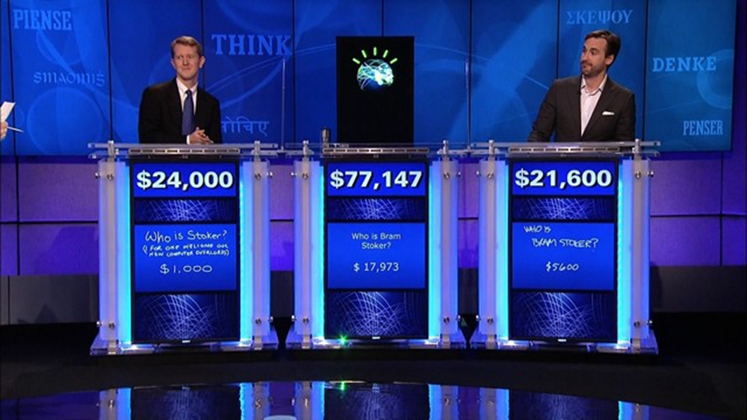
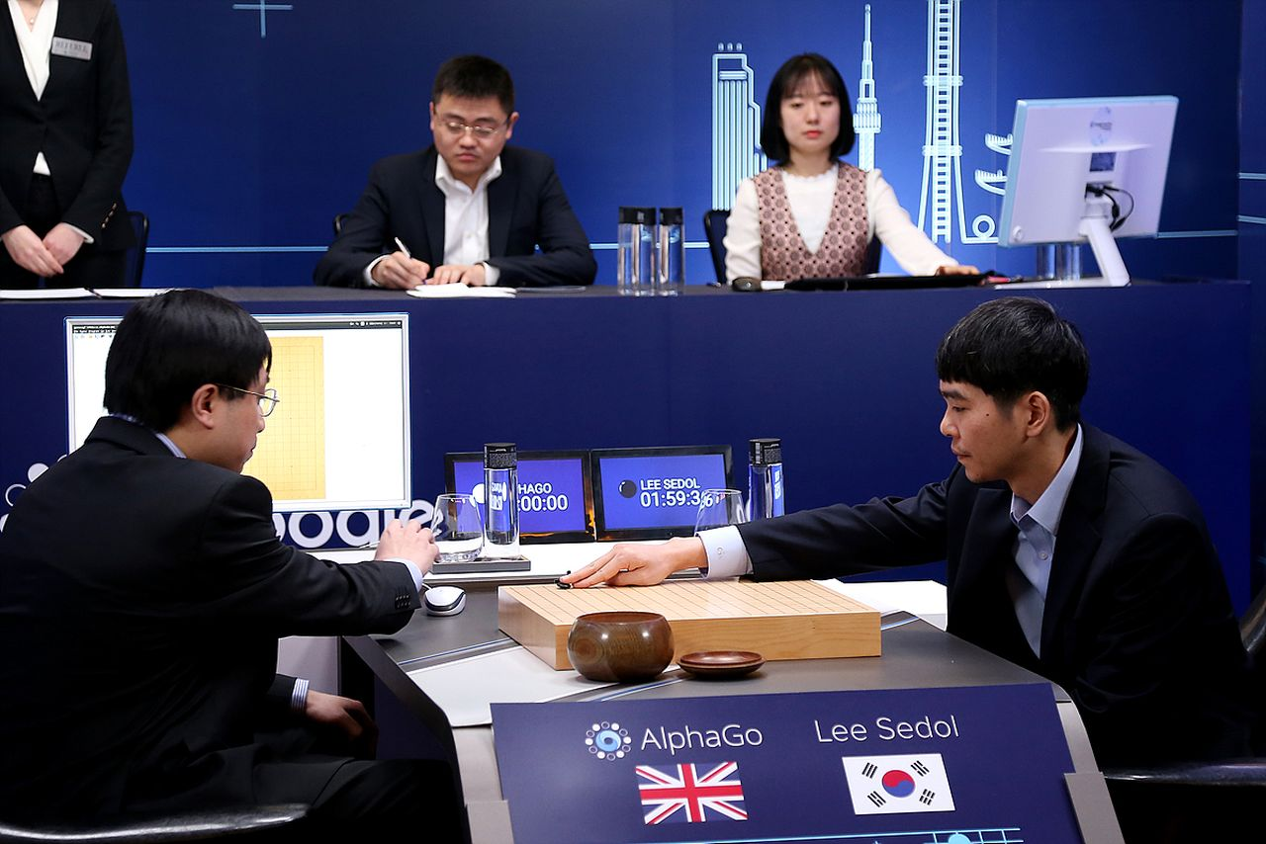
Famous Machine Learning Systems
Watson
AlphaGo

Slide 8
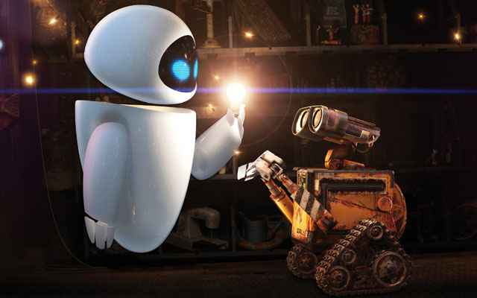
Views on Artificial Intelligence and Machine Learning
Symbolists -> Logic and symbols.
Connectionists -> Neural Networks.
Evolutionaries -> Genetic Algorithms.
Bayesian/Statistics -> Bayes Theorem.

Slide 9
Three Types of Machine Learning
Supervised Learning
Require a correspondence between input data and output labels.
Widely used for classification and regression problems.
Unsupervised Learning
The algorithm create output labels by distributing the input data into relevant groups of similar features.
Used for clustering and density estimation.
Reinforcement Learning
Penalty-Reward system where favorable actions are rewarded to increase the frequency of such actions.
Trade-off between exploration and exploitation.

Slide 10
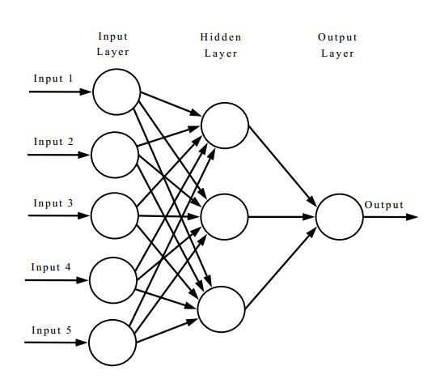
Symbols vs Connections: Models
Symbols
Connections

Slide 11
Symbols vs Connections: Strengths
Symbols
Connections
Concepts are defined using a top-down approach.
Organized Hierarchical Structure suitable for search trees and recursive thinking.
Handcrafted concepts which require human interpretation.
Intuitive - Neat and easy to understand.
Unique – One to one relation between symbols and concepts
Concepts are constructed using a bottom-up approach.
Concepts are built by the machine with minimal to no human interpretation.
Uniform processing – Computations can be divided and work in parallel.
Fault Tolerance – Network can still run, even with partial connections disabled.

Slide 12
Symbols vs Connections: Limitations
Symbols
Connections
Brittle - Performance of a model depends on the human’s knowledge of the environment.
Computationally Demanding - Each symbol only represents one concept.
Not enough abstraction - Too much data to label.
Static – Symbols cannot change once designed without human intervention.
Not intuitive for humans.
Problem of Opacity: network’s numeric coefficients are not accessible outside.
Parallel Paradox: “A camel is a horse designed by a committee”.

Slide 13
Machine Learning Algorithms
For this workshop I’ll focus on the following algorithms
Linear Regression
Logistic Regression
Convolutional Neural Networks (CNN)

Slide 14
Machine Learning Algorithms: Linear Regression

Slide 15
Machine Learning Algorithms: Logistic Regression

Slide 16
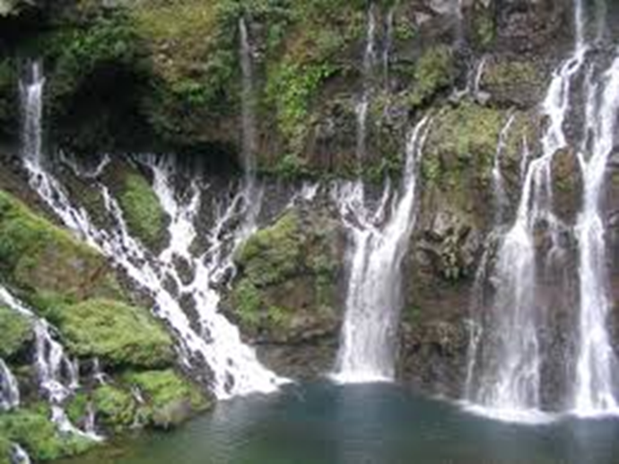

Machine Learning Algorithms: Deep Learning
Data flow is like a cascade.
Distributed: More possible configurations from small training representations.
$O\left(n\right) →O\left(2^{k}\right), n≤2^{k}$
Model is modified by the changes to the data over time.
Outperform most probabilistic models.

Slide 17
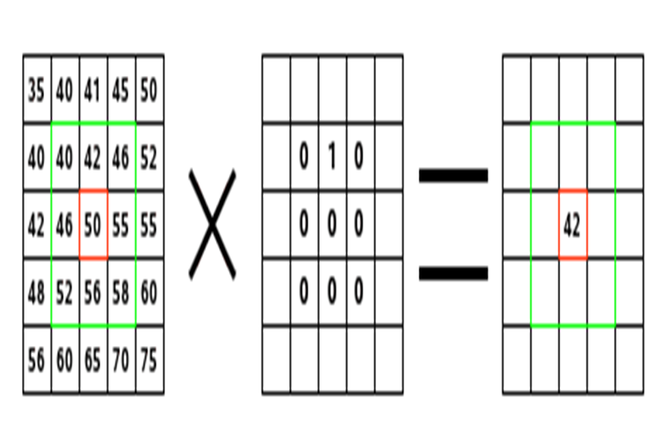
Deep Learning: Convolutional Neural Nets
Multi-layered Neural Networks
Minimizes number or parameters by convolution and subsampling.
Convolution: multiplies data with a filter to produce a filter map
Subsampling: Minimizes the size of the filter map by selecting a subset of its elements.

Slide 18
Courses For AI AND Machine Learning
CSE440: Intro to Artificial Intelligence
CSE491: Intro to Machine Learning
Learn the origins of AI from its conception in 1950 by Alan Turing to search, planning, vision, and other tasks with the symbolic views.
Have a view of how statistics help improve this research field
In-depth mathematical formulation and algorithms behind the most popular systems.
Learn to implement classifiers and regression algorithms (in theory and practice).

Slide 19
Artificial Intelligence Machine Learning Contest
Online Competition which test various algorithms and learning engines
Google TensorFlow
Microsoft Azure
MSU Developmental Network
Each team pay $270.00 entry fee
Team Leader gets tuition waver for all three summer courses.

Slide 20
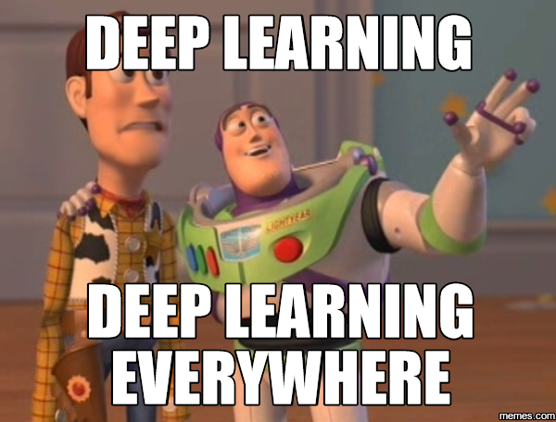
Popularity of Deep Learning
Google Invested 400 million of dollars on DeepMind Technologies and experts like Yoshua Bengio, Yan LeCun, Geoff Hinton.
Google Published the open-source engine TensorFlow.

Slide 21
TensorFlow
Take a 5-10 minute break!

Slide 22
Tensorflow
Open source software library for numerical computation using data flow graphs.
Data flow graphs describe mathematical computation with a directed graph of nodes & edges.
Nodes implement mathematical operations.
Edges describe the input/output relationships between nodes.
Only works with Python and an interface on C++.

Slide 23

Tensorflow Data Graph

Slide 24
Example 1: Linear Regression Model

Slide 25
Example 2: Logistic Regression

Slide 26
Example 3: Convolutional Neural Network

Slide 27
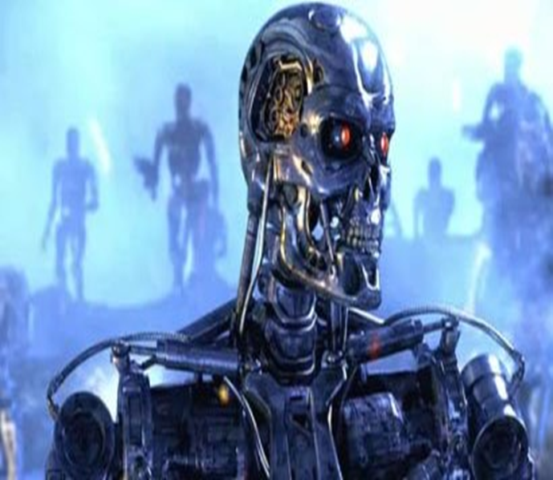
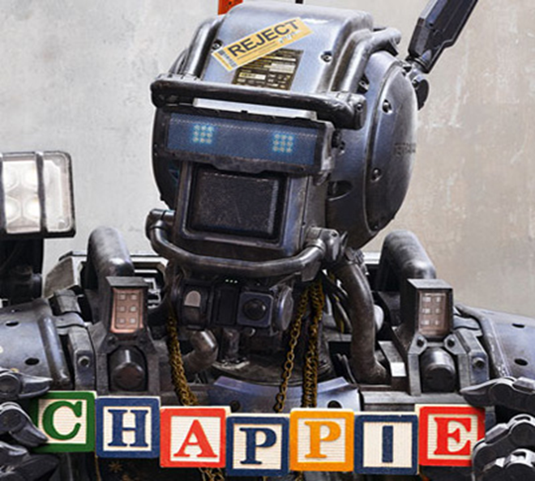
Ethics and Risks: Technological Singularity
Notes:
People like Elon Musk (Tesla Cars), Bill Gates, and Stephen Hawkings are strongly concerned about the future of AI. They believe that AI will define the end of humanity. I have two views regarding this matter:
Terminator - Machine without consciousness: Dominant view among sci-fi and popular media. This machine only think with logic (seeing black or white), not capable of understanding emotions, they stay within the boundaries of the models designed by the programmers.
Chappie - Machine with consciousness: Recent view. This machine is able to learn as a child. Be able to distinguish between good and bad, go beyond its programming,
Whether AI will become our extinction or the next step in our evolution depends on the model it is implemented on (Statistical or Developmental) and the environment these systems are exposed to.

Slide 28
Questions, Comment, Suggestions?
Email: juanlcastro3@gmail.com

